Slide 1

INTERNATIONAL COMPETITIVENESS

Slide 2

What does the syllabus say?
Global interdependence
linkages between economies, including trade, investment, tourism and immigration
the patterns and trends in global trade
the concept, and determinants, of international competitiveness
the concept, and extent, of globalisation
the factors facilitating globalisation
economic effects of globalisation

Slide 3

Learning intention
We are learning about the interdependence of nations in a global economy.

Slide 4

Success criteria
DEFINE the term international competitiveness.
DESCRIBE the factors influencing a nation’s international competitiveness.
EVALUATE the international competitiveness of Australia.

Slide 5
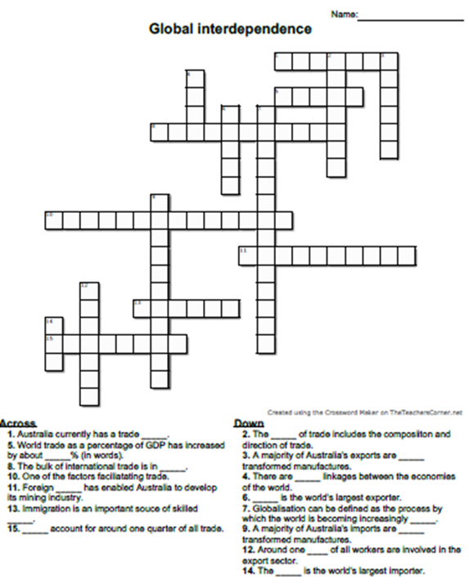
Time to think…
Review work that you have done on global interdependence by completing the crossword pictured to the right.

Slide 6

Key vocabulary
international competitiveness
exchange rate
labour productivity
unit labour costs
relative inflation rate

Slide 7

Time to think…
What do you think might be meant by the concept of international competitiveness?

Slide 8

How did you go?
International competitiveness refers to the degree to which a country can produce goods and services which meet the test of international markets, while simultaneously maintaining and expanding the real incomes of its people over the long term.

Slide 9
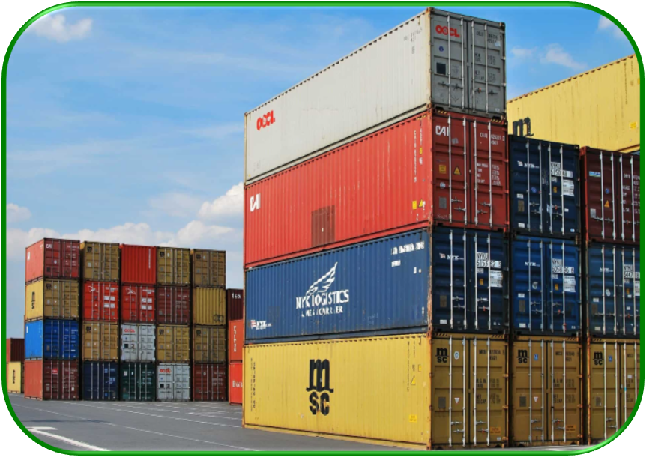
Let’s break that down…
Meet the test of international markets means…
Maintaining and expanding real incomes means…
Over the long term because…

Slide 10
What determines international competitiveness?
INTERNATIONAL COMPETITIVENESS
Government policies
Relative inflation rates
Labour productivity
Research and development
Exchange rate
Education and Training
Read pages of your text then complete the following:
EXPLAIN the importance of international competitiveness for a nation.
SUMMARISE the key determinants of a nation’s international competitiveness.

Slide 11

How does Australia rank?
Read the article on Australia’s international competitiveness found at IMDB World Competitiveness Yearbook 2022, then complete the following:
IDENTIFY Australia’s competitiveness ranking for 2022 and COMPARE this to the ranking for 2021.
EXPLAIN why Australia’s ranking has improved with reference to the factor breakdown graph.
DESCRIBE the trend in Australia’s competitiveness ranking from 2002 to 2022. PREDICT the impact that this will have on Australia’s standard of living in the long term.
OUTLINE the areas of relative strength for Australia with respect to our international competitiveness in 2022.
IDENTIFY the areas of relative weakness for Australia with respect to our international competitiveness in 2022.

Slide 12
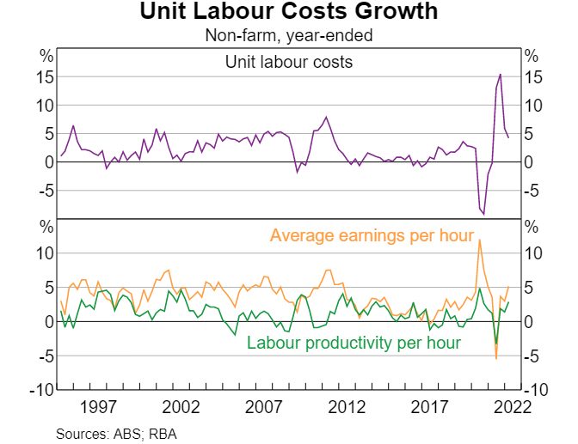
Before you go…
Examine the source to the right then complete the following:
IDENTIFY the relationship between unit labour costs and labour productivity between 2020 to 2022.
DESCRIBE the overall trend in unit labour costs between 2020 and 2022.
DISCUSS the effect of this change in unit labour costs on Australia’s international competitiveness.

Slide 13
How can I support my learning from today?
Test your understanding on the success criteria each day. Address any gaps in your learning.
Take Cornell notes on Chapter One of the text organised under the syllabus dot-points.
Complete ISP – Global Interdependence.
Create a glossary of key economic terminology.

Slide 14
Success criteria checklist
I CAN…
DEFINE the term international competitiveness?
DESCRIBE the factors influencing a nation’s international competitiveness?
EVALUATE the international competitiveness of Australia?

